Slide 1


Flex-connect
Team conversation guide
Notes:
Note this is a guide only, to aid conversation, and should be used in consideration of your organisation's flexible work policy.

Slide 2
Before you have the conversation
Read about
1
Queensland Government’s flexible work approach – see Flex-connect framework.
Think about
Different types of flexibility, consider the benefits and draft your flexible work agreement – see Flexible work for employees.
2
Notes:
Managers should also read Flex-connect for managers​

Slide 3

Agenda
Why discuss flexible working as a team?
Principles for the conversation.
The happy-medium.
Hybrid working personas
  What is your persona?
Needs for flexible working:
  You
  Team
  Customer
  Manager
  Organisation
What can we start, stop and continue doing to make flexible working a success?
Next steps.

Slide 4
Why discuss flexible working as a team?
Teams have a critical role to play in ensuring optimal flexible work approaches.
The flexible work approaches of team members will likely impact the whole team and as such it is important that options and solutions are considered with everyone in mind.
Better outcomes will be achieved when team members actively participate in discussions and are open-minded and innovative in designing appropriate flexibility options.
Options should have a positive or neutral impact on team outcomes and consider team commitments and deliverables, the quality of stakeholder relationships and the need to ensure ongoing collaboration, innovation and creativity.

Slide 5
Working for Queensland data suggests greater wellbeing is significantly correlated with teams and managers that discuss and design appropriate flexible work approaches.

Slide 6


Principles of this conversation
What principles would we like to put in place before we begin this discussion?
Option A
Option B
Discuss as a group.
Prepare a simple MS Teams poll Word Cloud where all team members can share their ideas.
Discuss as a group.
Notes:
Create a safe space – discuss principles about how you will have this conversation.​
​

Slide 7
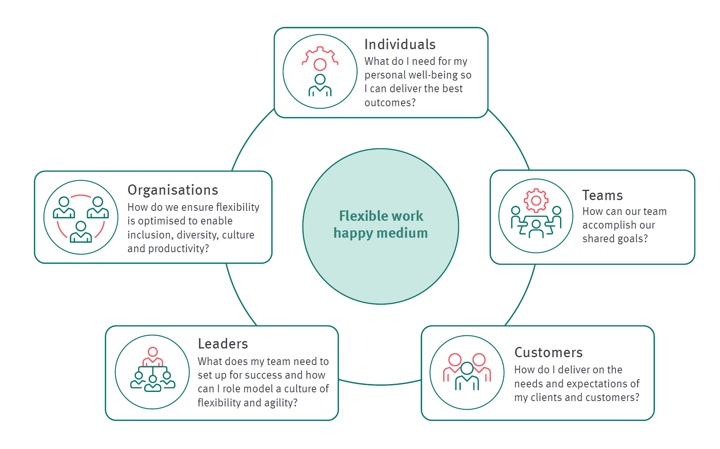
What is the happy medium?
Notes:
Discuss what a high performing team looks like.
What does this team look like when we’re at our best? How would we like others to describe our team?
Discuss the happy medium diagram:
Who are the main stakeholders/customers/partners (both internal and external) we regularly connect with to deliver our outcomes?
What concerns do people have – go through the diagram to identify any issues that might arise. What might be the impacts of our proposed approaches?
What solutions could we develop to address these concerns (e.g. having a common day in the office, developing a quarterly staff forum that enables people whose days/shifts don’t overlap to mix socially).

Slide 8

Hybrid working personas
Understanding the differing views, needs and mental models of team members will assist in making hybrid arrangements work.
These personas are intended to prompt thinking about working styles rather than personalities.
Notes:
These personas are based on ideas from personas developed by Bendelta – see: https://www.bendelta.com/wp-content/uploads/2022/02/worksona-Insights-2022.pdf

Slide 9

People people
Draws their energy and creativity from being face to face. Often extroverts.
Enjoys the interaction and pace of the workplace.
Learns a lot from observation and conversation with colleagues.
Feels too much time away from the workplace can be disengaging.
Notes:
These personas are based on ideas from personas developed by Bendelta – see: https://www.bendelta.com/wp-content/uploads/2022/02/worksona-Insights-2022.pdf

Slide 10

Traditionalists
Mostly always worked in the workplace.
Enjoys the rhythm and ease of having everything in one place and the available technology.
May not be sold on the value for the team of hybrid working.
If a manager, needs to understand the differing drivers and motivations for other team members.
Notes:
These personas are based on ideas from personas developed by Bendelta – see: https://www.bendelta.com/wp-content/uploads/2022/02/worksona-Insights-2022.pdf

Slide 11

Wanderers
Feels connected and productive regardless of location.
Values autonomy, flexibility and wellbeing.
Time away from workplace recharges batteries and improves commitment and job satisfaction.
Managers need ensure wanderers remain connected to the team and organisation.
Notes:
These personas are based on ideas from personas developed by Bendelta – see: https://www.bendelta.com/wp-content/uploads/2022/02/worksona-Insights-2022.pdf

Slide 12

Accommodators
Flexes as needed and will adjust their style accordingly.
May have fluid or non-rhythmic routines outside of work or part of the sandwich generation with multiple care-giving roles.
Probably balance time in the workplace and from a remote location.
Challenge may be making sure they have access to the right tools and support so they can contribute to team projects regardless of the hours they work.
Notes:
These personas are based on ideas from personas developed by Bendelta – see: https://www.bendelta.com/wp-content/uploads/2022/02/worksona-Insights-2022.pdf

Slide 13
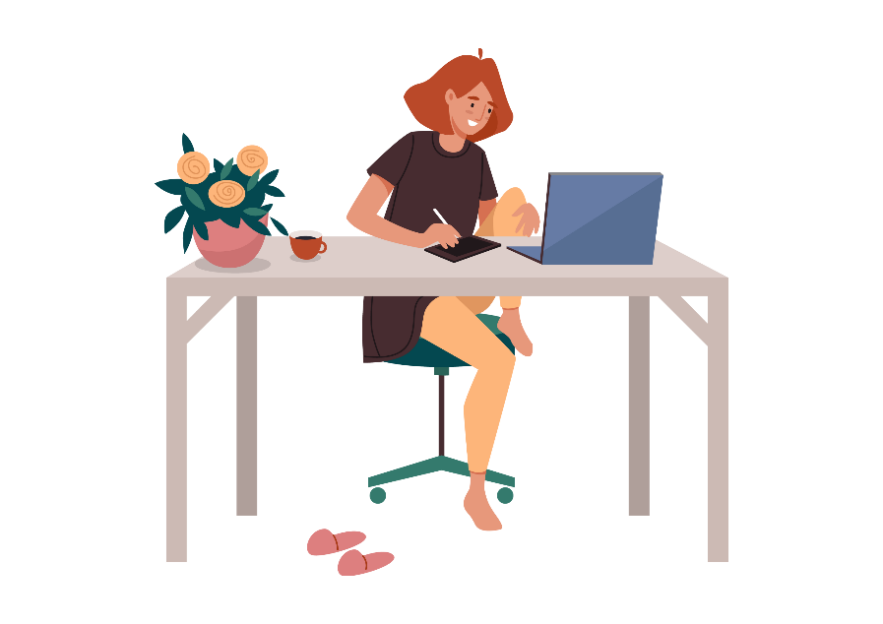
Home bodies
Prefers to work from home as much as possible.
Comes into the office for a special meeting or event.
Open floor plans with high traffic may drain their energy.
Ensure they have routines in place to be able to switch off from work at the end of the day.
Think about how to accommodate the needs of the team when IRL collaboration is required.
Notes:
These personas are based on ideas from personas developed by Bendelta – see: https://www.bendelta.com/wp-content/uploads/2022/02/worksona-Insights-2022.pdf

Slide 14

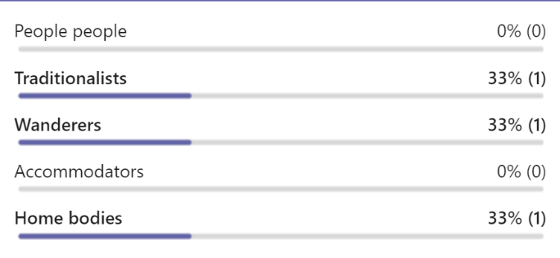
What hybrid working persona best reflects you?
Option A
Option B
Discuss as a group.
Prepare a simple MS Teams poll where all team members can share their preference.
Discuss as a group.

Slide 15


Note
Individuals need not disclose information about personal circumstances or other information they would consider private. This should be a more general conversation about preferred flexibility options.
What do you need?
What kind of flexibility do you need to be at your best?
Option A
Option B
Discuss as a group.
Prepare a simple MS Teams sticky note whiteboard where all team members can share their needs.
Discuss as a group.
Notes:
Ask everyone to provide a summary of the flexible work approach they would ideally like​.
​

Slide 16

As a team, what does good look like? What do we need?
Option A
Option B
Discuss as a group.
Prepare a simple MS Teams sticky note whiteboard where all team members can share their ideas.
Discuss as a group.
Notes:
Discuss what a high performing team looks like.
What does this team look like when we’re at our best?
How would we like others to describe our team?​
​

Slide 17

What do our customers need?
Option A
Option B
Discuss as a group.
Prepare a simple MS Teams sticky note whiteboard where all team members can share their ideas.
Discuss as a group.

Slide 18
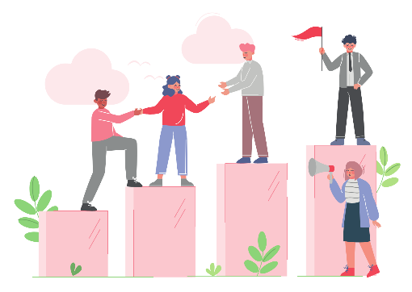
What do we think our leaders need?
Option A
Option B
Discuss as a group.
Prepare a simple MS Teams sticky note whiteboard where all team members can share their ideas.
Discuss as a group.

Slide 19

What do we think is important from an organisational perspective?
Option A
Option B
Discuss as a group.
Prepare a simple MS Teams sticky note whiteboard where all team members can share their ideas.
Discuss as a group.

Slide 20
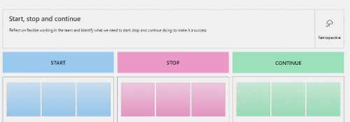
Let’s start…
What should we start doing to ensure we are at our best as a team, and finding the happy medium?
Option A
Option B
What ideas do we have?
What could we do differently?
Discuss as a group.
What ideas do we have?
What could we do differently?
Prepare a simple MS Teams whiteboard where all team members can share their ideas on stickers.
Discuss as a group.
Notes:
As a team: what flexibility is working?​
What other ideas do people have?​
What concerns do people have – refer to the Happy medium diagram to identify any issues that might arise. What might be the impacts of our proposed approaches?​
What solutions could we develop to address these concerns (e.g. having a common day in the office, developing a quarterly staff forum that enables people whose days/shifts don’t overlap to mix socially) ​
Other issues you might discuss​
What could we change about how this work is done? (e.g. options for sharing responsibilities, working from a Distributed Work Centre, using different technology etc).​
How could we measure productivity and impact, and what success (and quality) looks like?​
What does the team need to thrive in the employer provided workspace?​
How might our roles be redesigned with wellbeing in mind?​
What implementation challenges can we foresee and how might we resolve these?​
​

Slide 21
Let’s stop…
What could we stop doing or change to ensure we are at our best as a team?
Option A
Option B
What is not working, or we can change?
Discuss as a group.
What is not working, or we can change?
Prepare a simple MS Teams whiteboard where all team members can share their ideas on stickers.
Discuss as a group.

Slide 22
Let’s continue…
What's working really well with our flexible work approach that we'd like to continue or build on?
Option A
Option B
What is working fabulously?
What do we not want to lose?
Discuss as a group.
What is working fabulously?
What do we not want to lose?
Prepare a simple MS Teams whiteboard where all team members can share their ideas on stickers.
Discuss as a group.

Slide 23

Where to from here…
Agree on a date when everyone will submit a Flexible Work Agreement.
Agree how you’ll share info about your approaches and keep each other up to date on progress, successes, concerns and innovations.
Set a review date as per your organisation’s flexible work policy.
Notes:
Agree on the process for escalating issues.​
Build in elements for monitoring, review and evaluation in accordance with your organisation’s flexible work policy.​
Nurture a culture that encourages experimentation and trialing new and different ways of working.​
​

