Slide 1
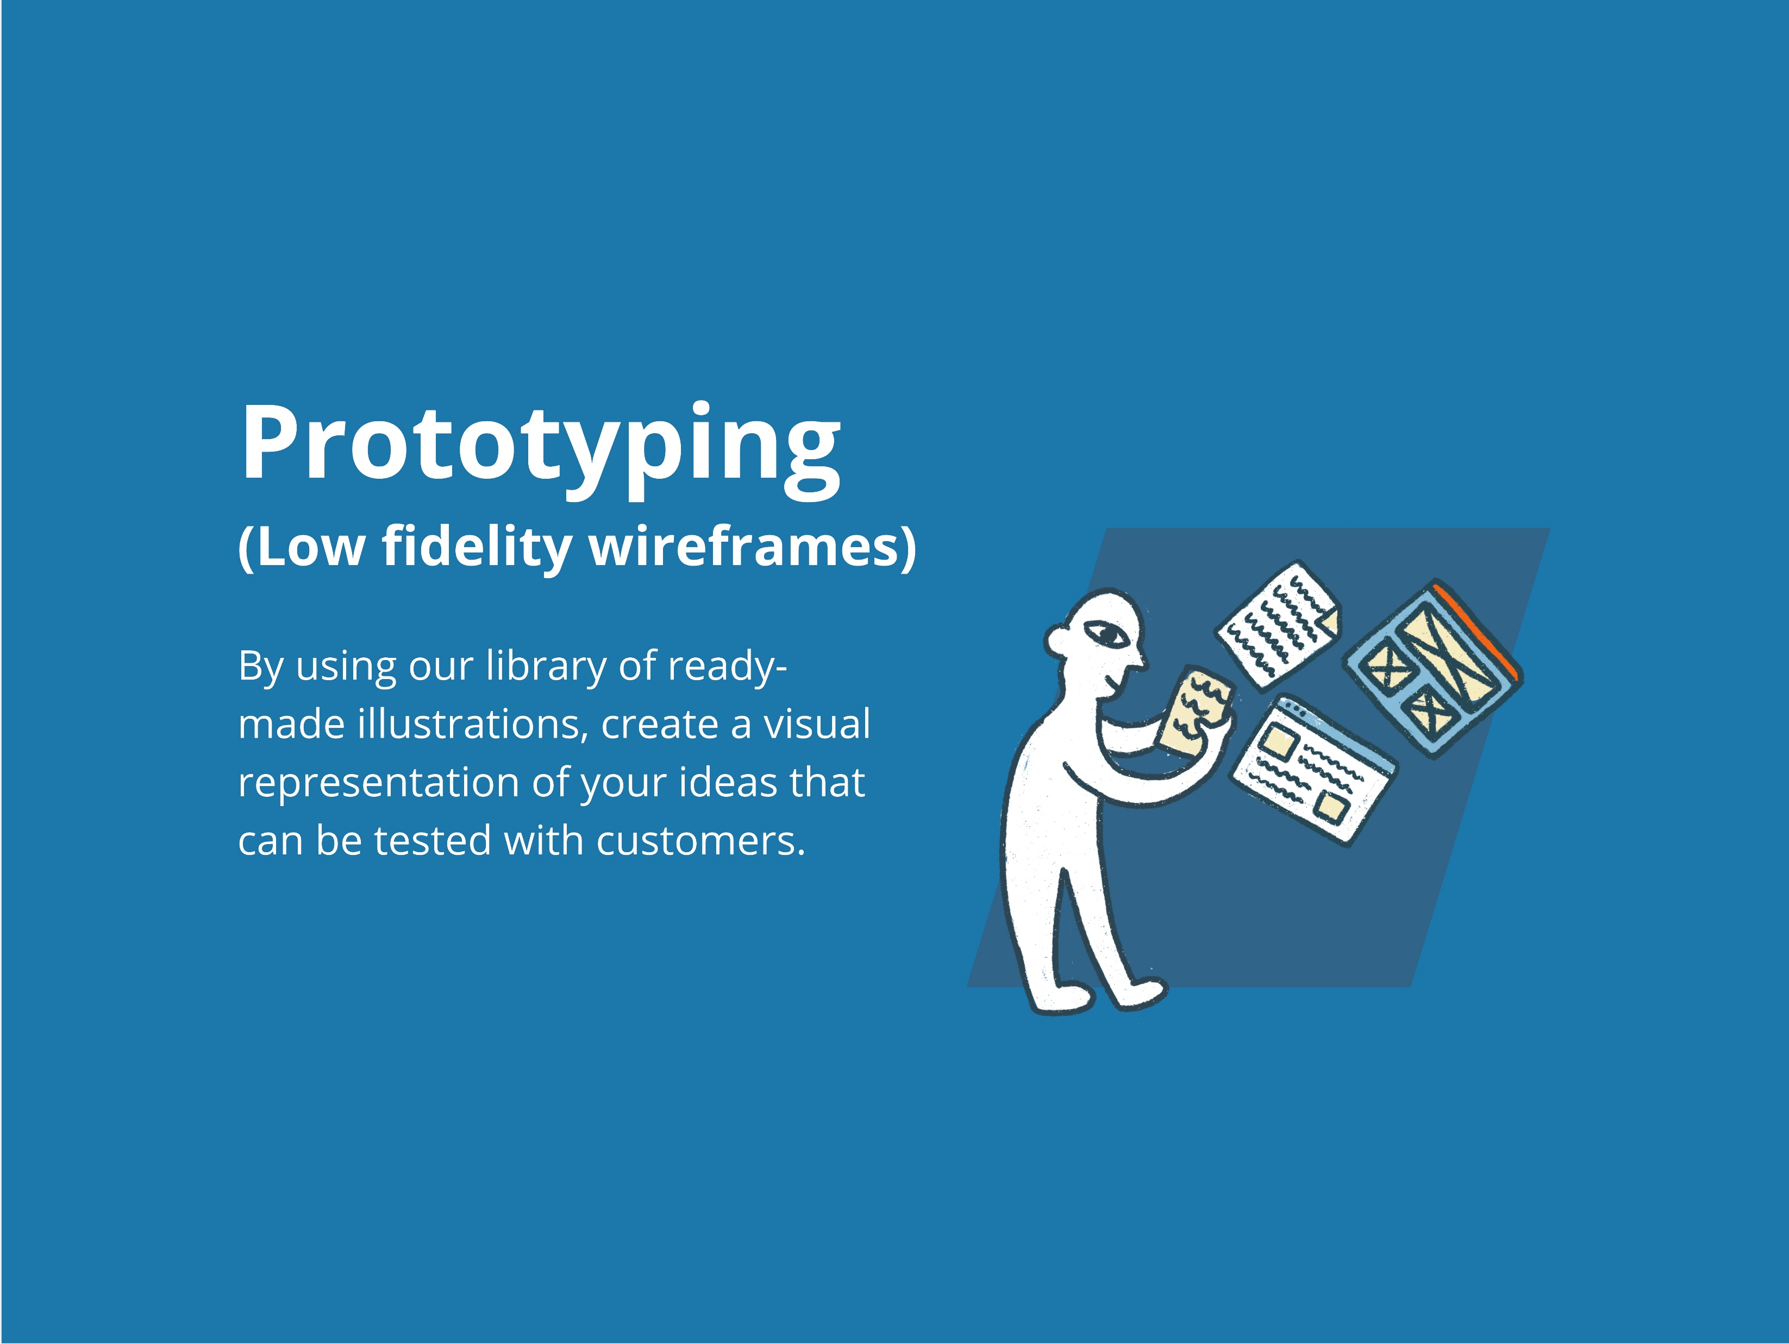


Slide 2
Browser prototyping
Digital wireframing resource

Slide 3

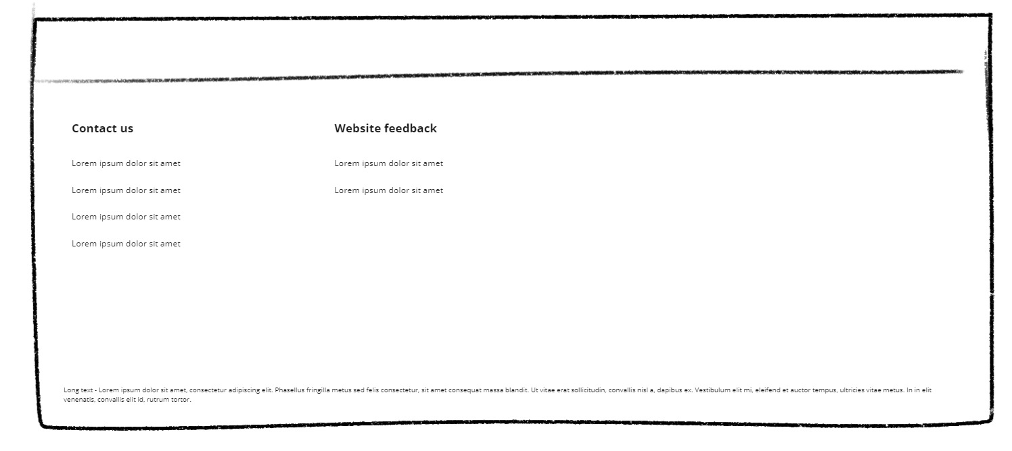

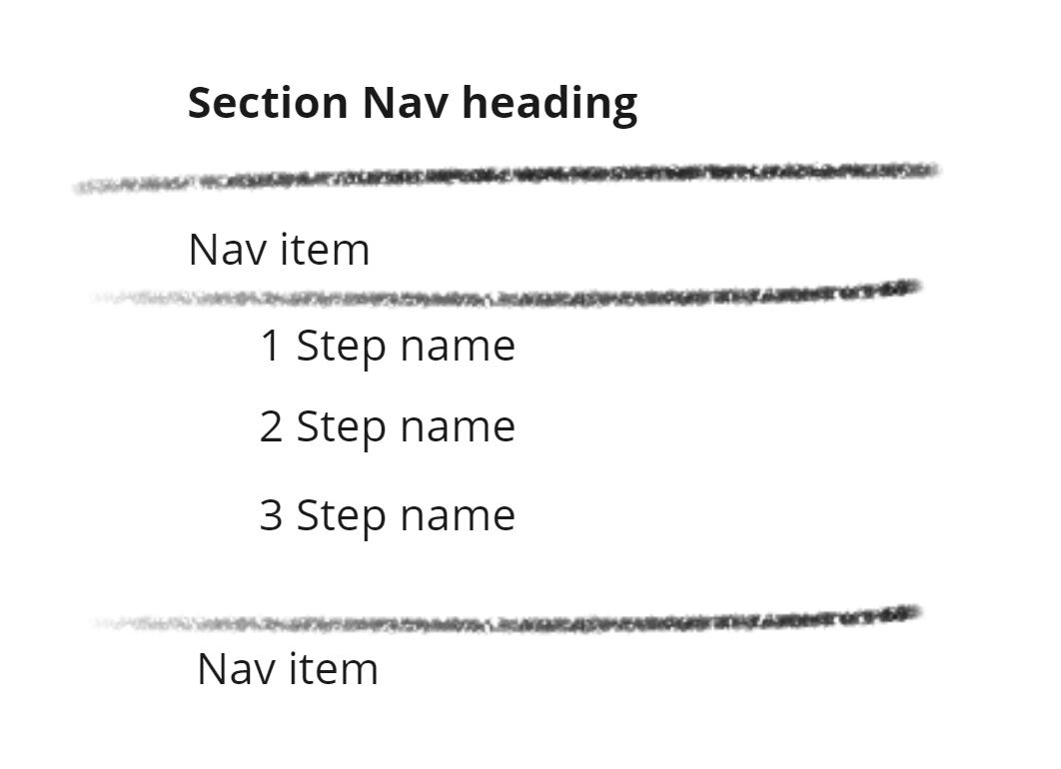
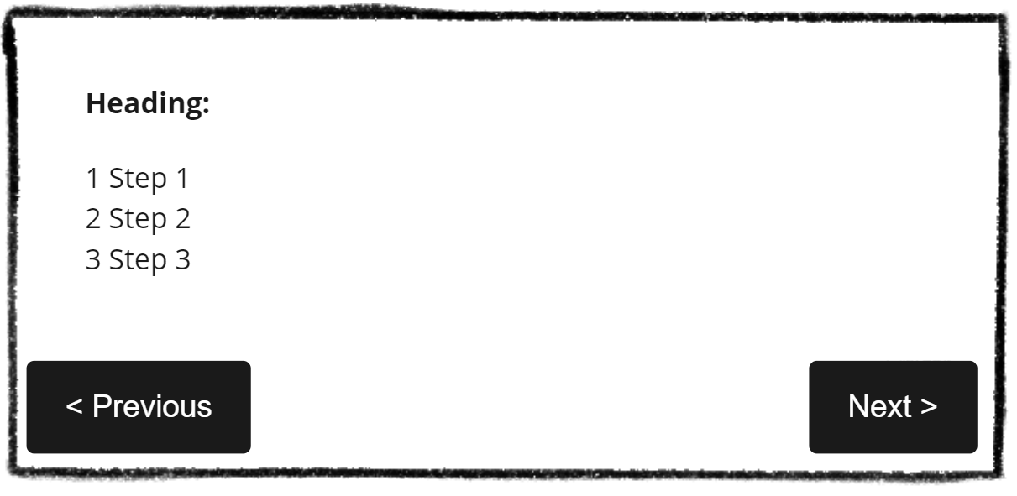
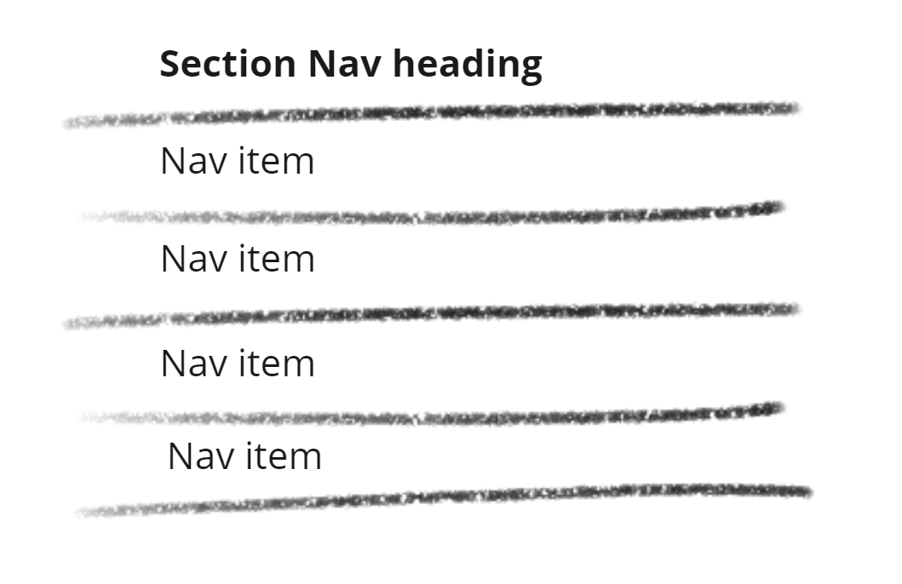

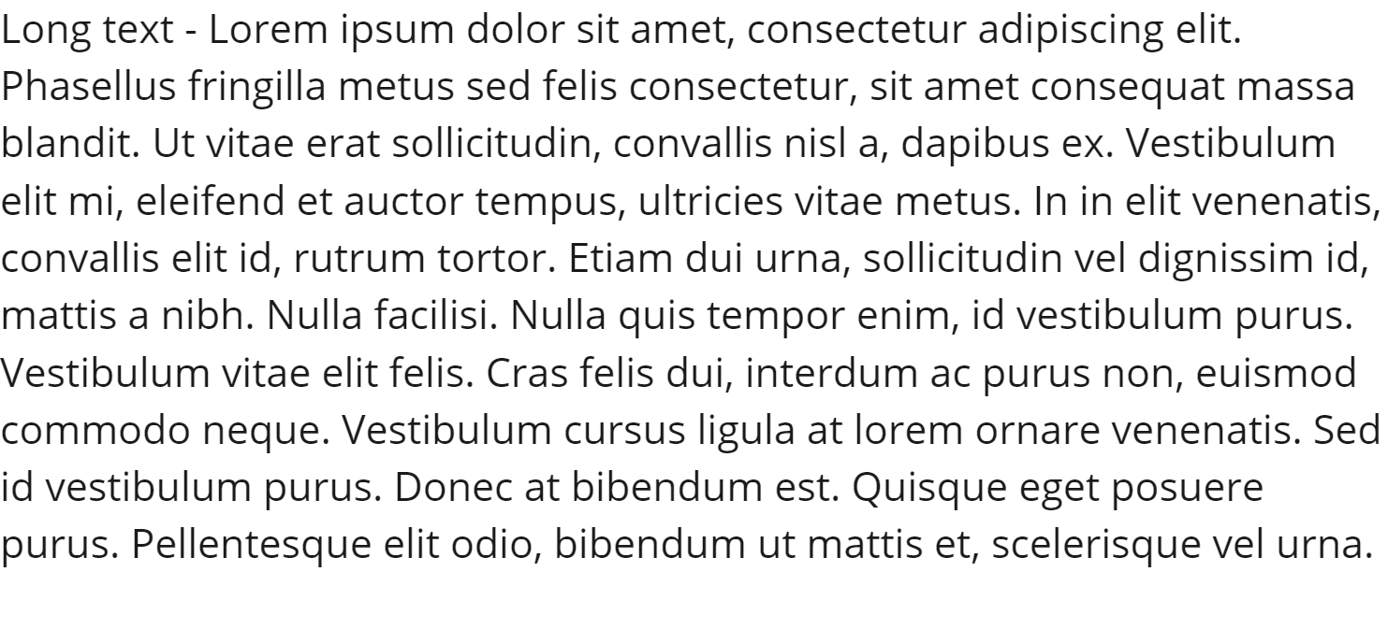

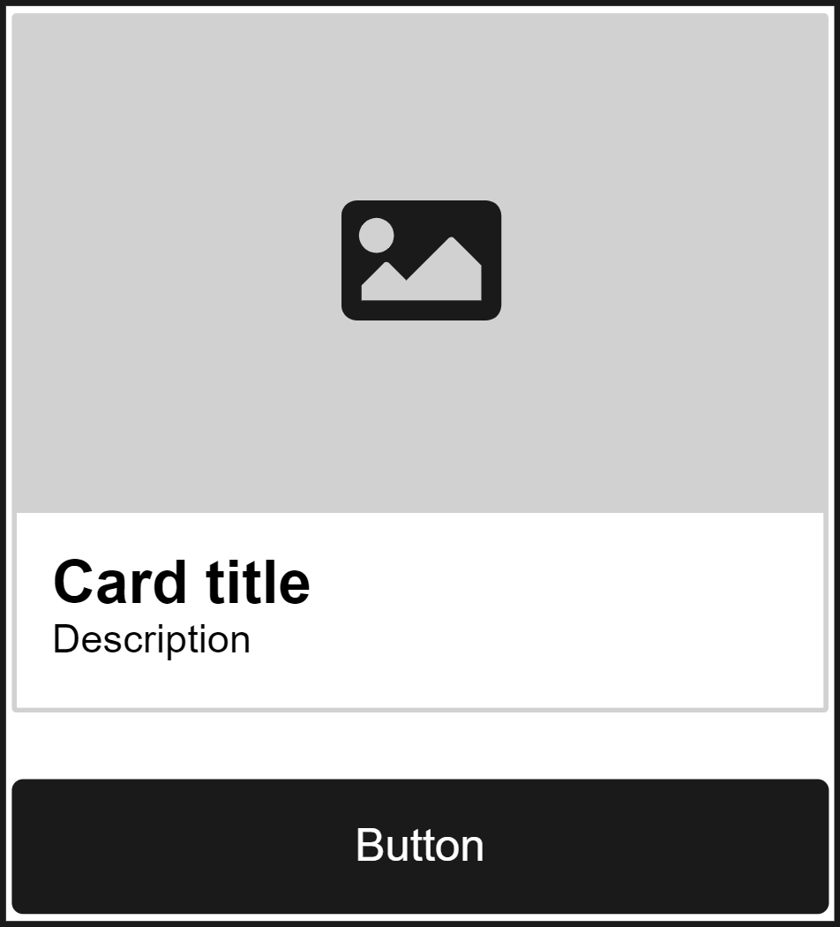
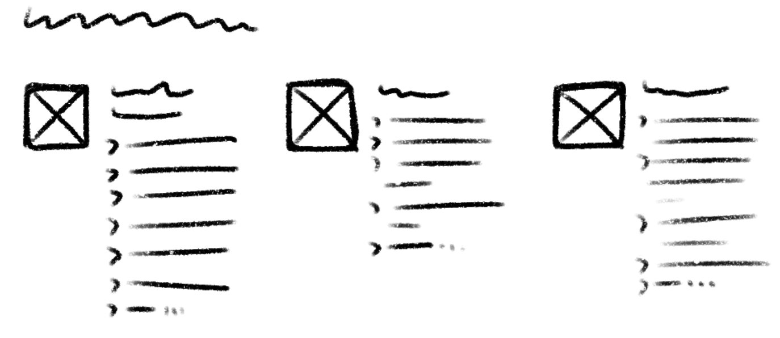
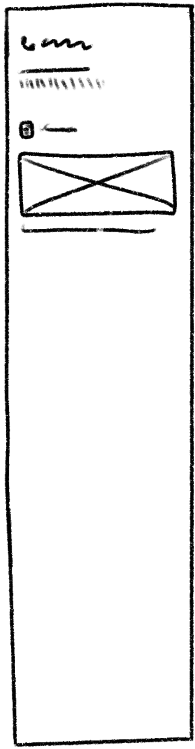
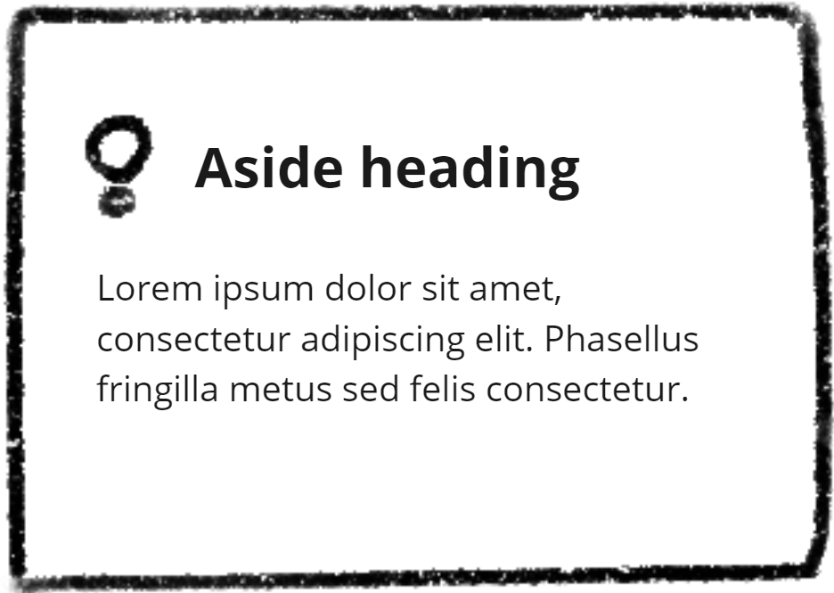



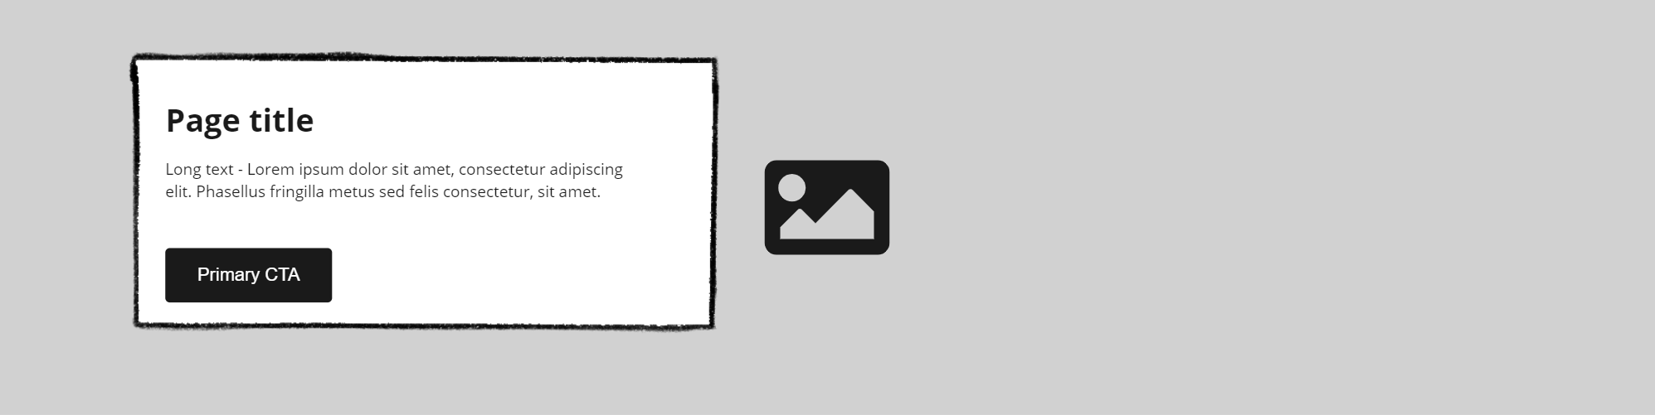
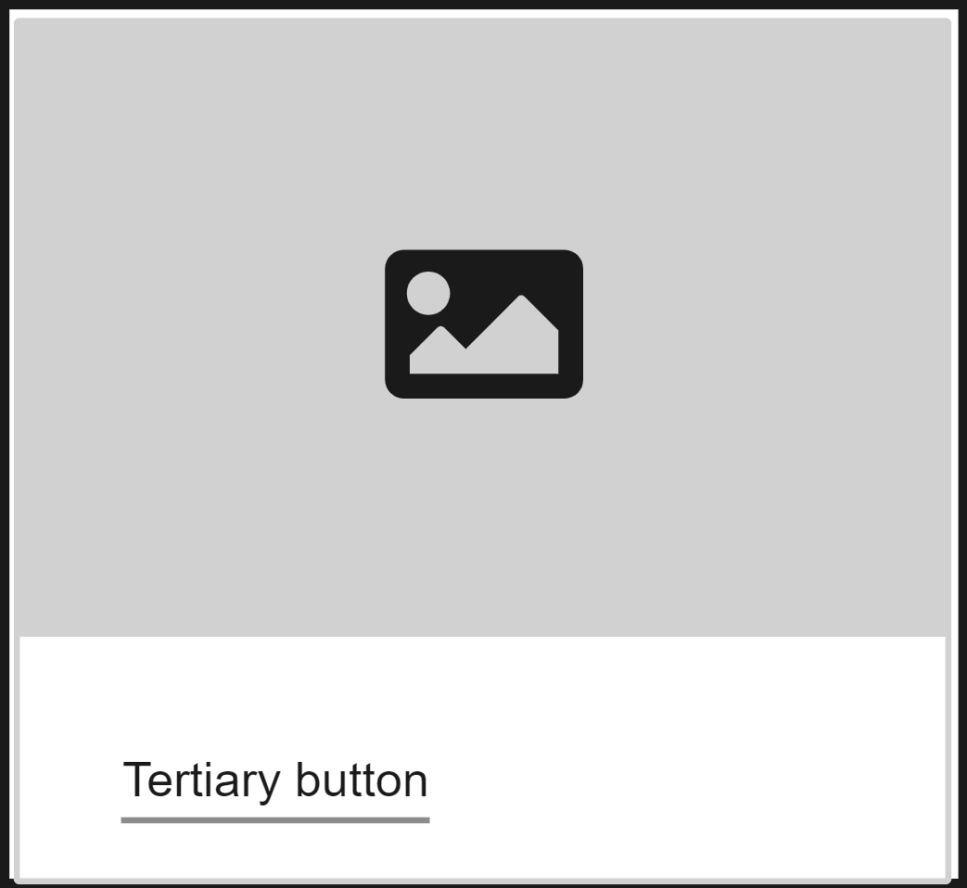
Prototype
Add the visual components to the working space below.
Drag and drop or copy and paste the visuals
Top banner
Footer
Browser frame (expandable)
Navigation (guide page)
Navigation
Drag and drop or copy and paste the visuals
Hero banner image
Text
Aside boxes
Buttons
Cards
Franchise layout
Other visuals
Add your own visual elements here.
Right side of web page
Middle content section
Hero banner image
with call to action (CTA)

Slide 4
Browser prototyping
Printable wireframing resource

Slide 5
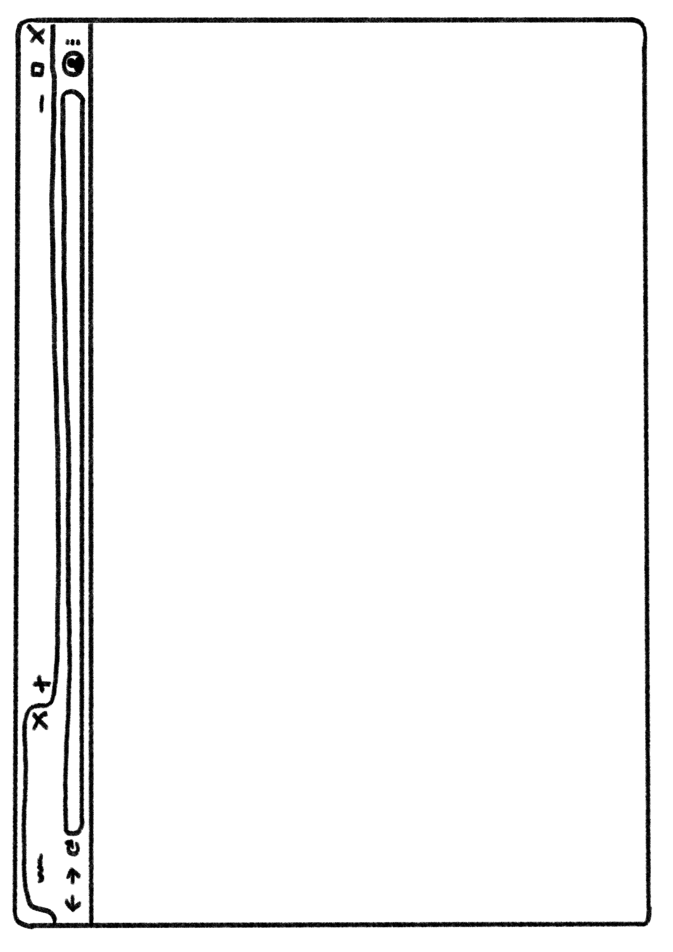

Slide 8
Mobile prototyping
Digital wireframing resource

Slide 9
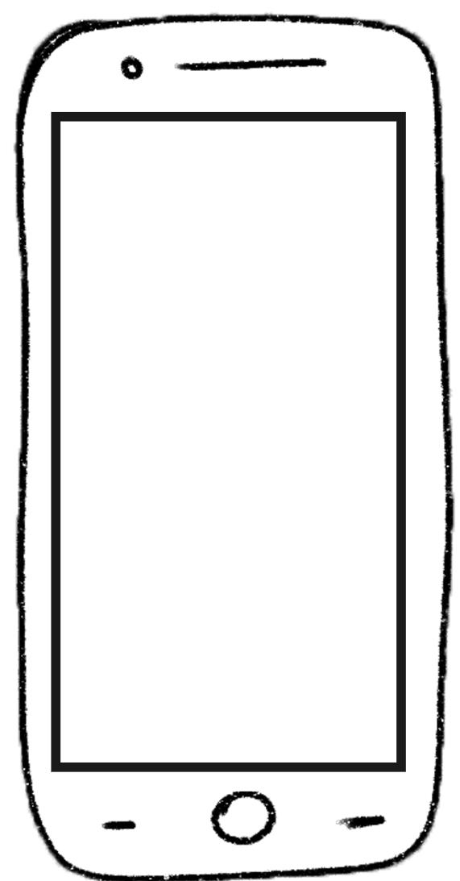




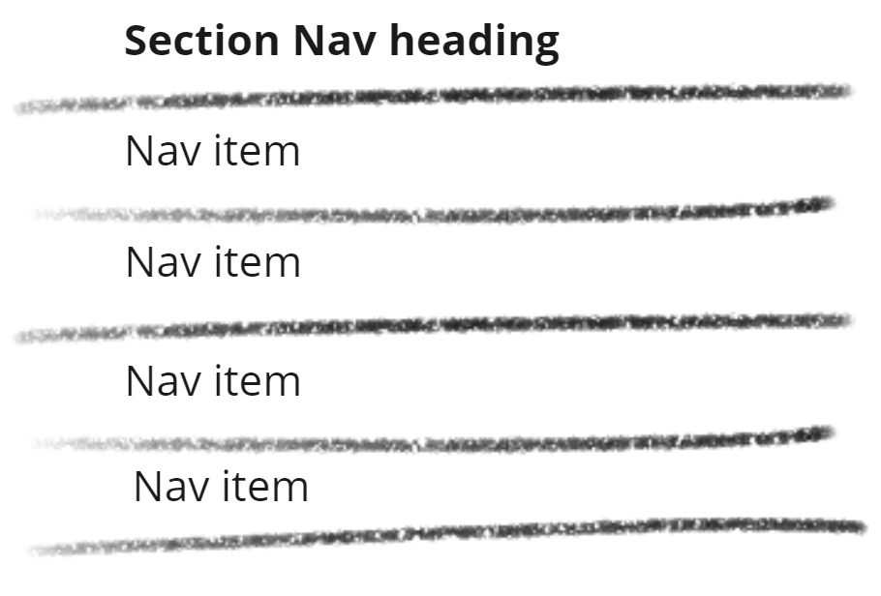
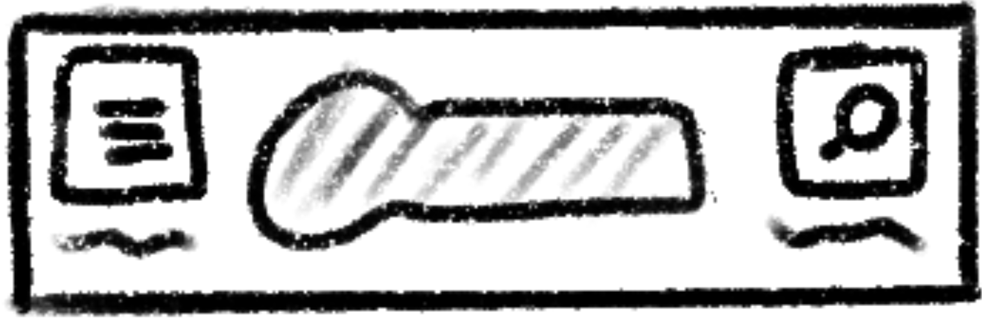


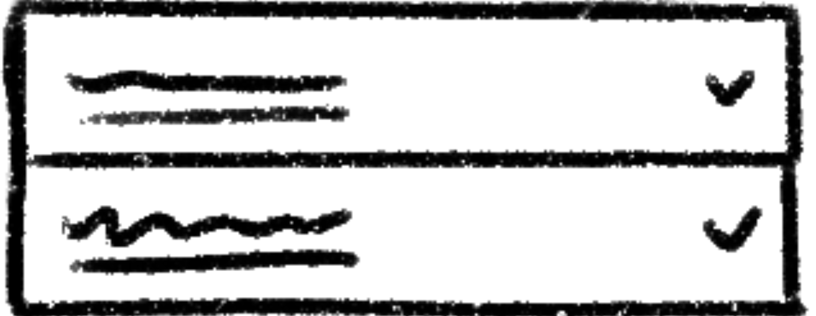
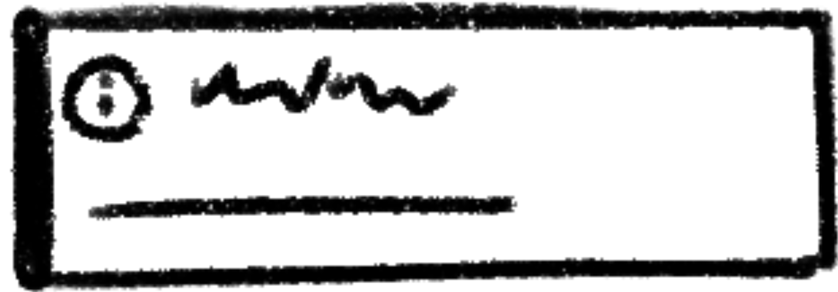

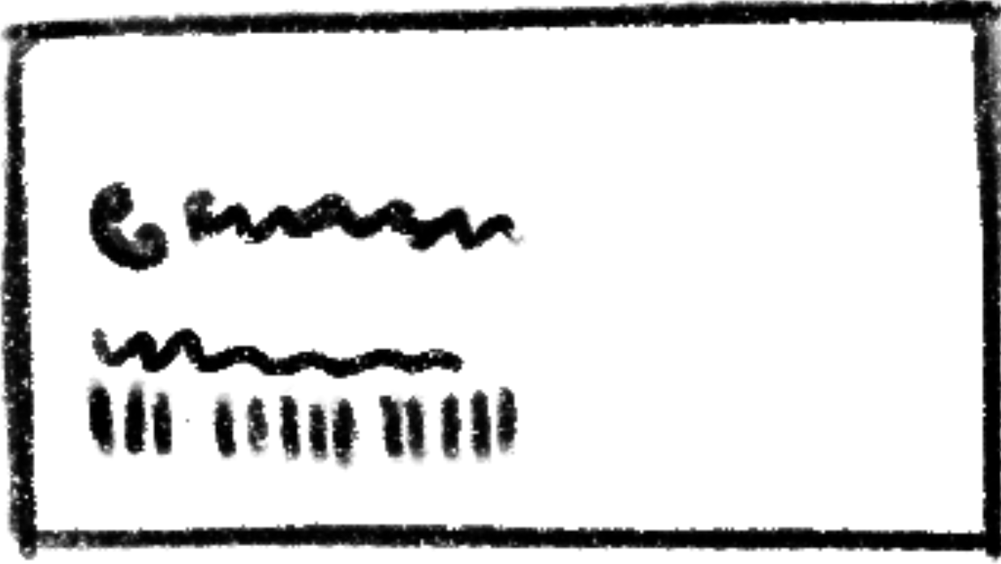
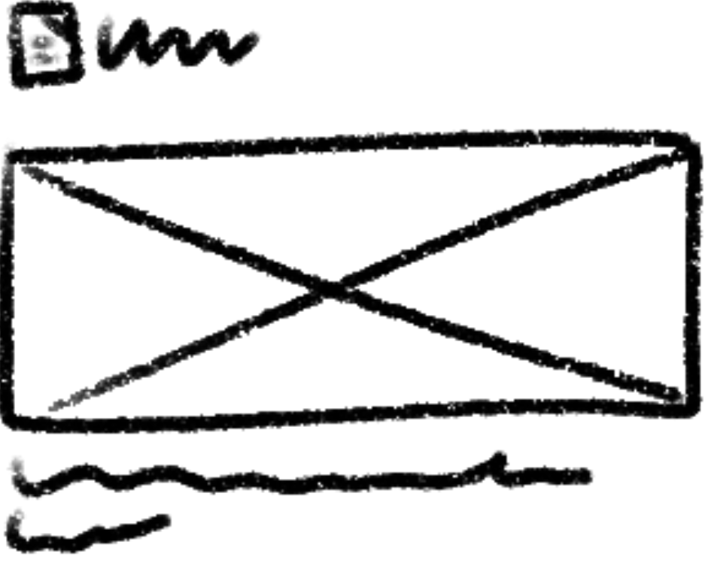


Prototype
Add the visual components to the working space below.
Drag and drop or copy and paste the visuals
Phone template
Browser frame (expandable)
Text
Navigation
Drag and drop or copy and paste the visuals
Top menu bar
Aside
Photos
Accordion menu
Info box
Warnings
Contact
News/other
Buttons
Other visuals
Add your own visual elements here.

Slide 10
Mobile prototyping
Printable wireframing resource

