Slide 1
Future state customer journey mapping examples

Slide 2
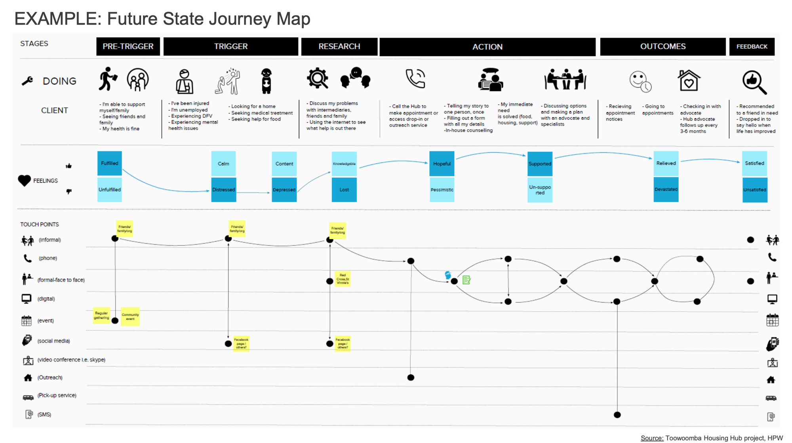

Slide 3
