Slide 1
QGEA Metamodel
v1.0 January 2025
© The State of Queensland (Department of Customer Services, Open Data, Small and Family Business ) 2025 licensed under Creative Commons Attribution-NonCommercial-ShareAlike 4.0 International
To view the terms of this licence, visit http://creativecommons.org/licenses/by-nc-sa/4.0/. For permissions beyond the scope of this licence, contact qgea@qld.gov.au.
To attribute this material, cite the Queensland Government Customer and Digital Group, Department of Customer Services, Open Data, Small and Family Business)

Slide 2
Background

Slide 3





Organising Knowledge
A metamodel defines containers and connections to capture a set of views of your organisation, enabling you to understand context, scope, impacts of doing what you do and responding to external or internal change.
Container
Business
Business
Organisation Structure, Goals, Objectives,
Capabilities, Processes, Initiatives
Customer
Products and Services, Stakeholders, Value Chain
Information
Business information assets, Key Data
Technology
IT Systems, Software, Hardware
Customer
Information
Technology
Insight
(Change impact. What-if analysis)
Connection

Slide 4

What is this knowledge for? – two halves of the brain
Government Lines of Business
  Designing your business to deliver your services
  Strategic business planning
  Strategic ICT Resources Management
  Planning business change and responsiveness
  Sharing experience with other agencies
Whole of Government
  Portfolio Management
  Determining Core & Common candidates
  Informing future state blueprint and target architecture
  Sharing insights across government
A Queensland Government metamodel provides a common language to compare organisations and initiatives, and to exchange and reuse definitions and business models.

Slide 5





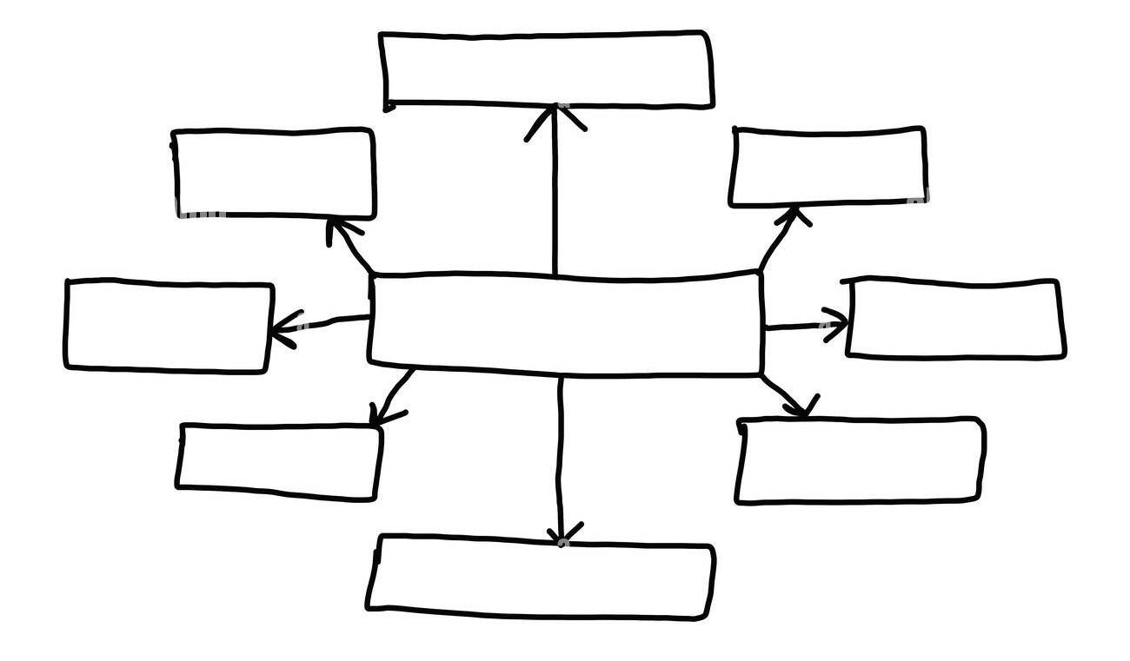
QGEA Metamodel – leveraging standards
ICT Resources Strategic
Planning Policy
Digital and ICT Strategic Framework
ISO 38500:2016 Governance of IT for the organisation
Governance “a system that directs and controls the current and future state”
EA framework and method to capture Current and Target states
Industry metamodel
QGEA Metamodel
Subset of industry metamodel and extensions
Mapping of generic terms, to Government language

Slide 6

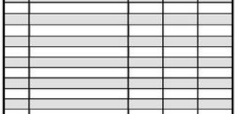





Incorporating the Metamodel
Update your model as your organisation changes
Deliver Insights
to assist decision making in your organisation and implementing your future plan
Model your organisation
according to QGEA Metamodel & Data Dictionary
    Use the guidelines if you have an existing Enterprise Architecture tool
Conduct Business Planning
aligned to ICT Resources Strategic Planning Policy & Digital and ICT Strategic Framework
Contribute
To the Whole of Government viewpoint by providing elements of your model and insights

Slide 7
The Metamodel

Slide 8
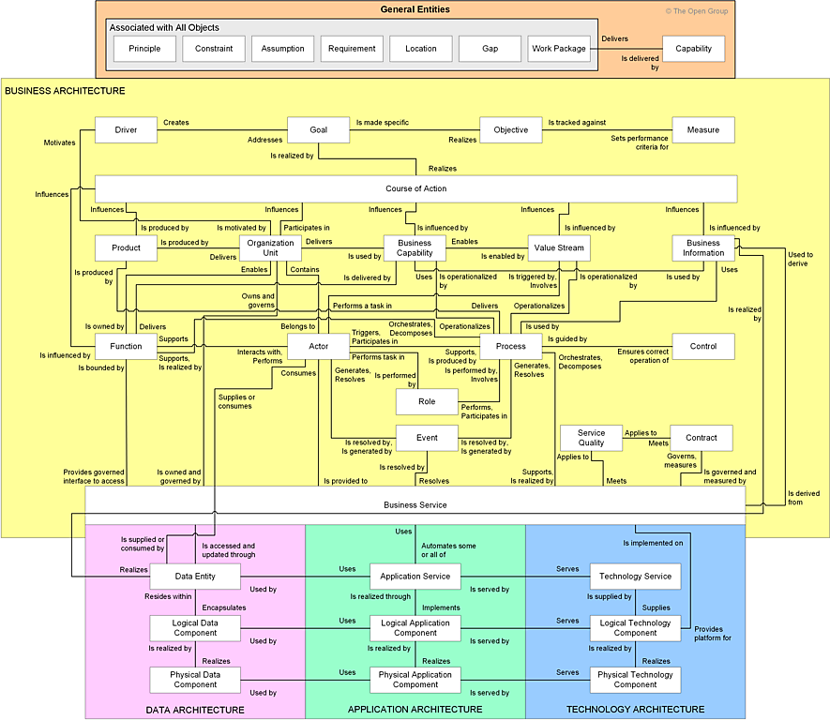
QGEA Metamodel
TOGAF Alignment
The QGEA Metamodel utilises a subset of objects from the TOGAF Content Metamodel. Note that implementers are welcome to use all TOGAF objects as required, however key reportable information under the QGEA will be held in the selected objects.

Slide 9
QGEA Metamodel
Capability-centric Views
The QGEA Metamodel collectively describes business capability in terms of views that detail the reason for the capability, its outputs, and the elements that make up its delivery.
Motivation
(Whole of Government,
Business)
Products/Services,
Customers/Stakeholders
Business Capability
Capability Dimensions
(People, Process, Information, Resources)
Work Package
(Change via Initiatives, Projects, and Programs)

Slide 10
QGEA
Metamodel
Extensibility
Note: the metamodel is an EA perspective and is not intended to be a comprehensive model, for example, on project management or ICT asset management.
Implementers can use it as a hub to connect to these other models, which are often found in specialised repositories such as CMDB, Risk Management tools, or Portfolio Management platforms. Ideally, these other tools should integrate with the repository storing QGEA Metamodel content.
Business Motivation Modelling
Governance Risk and Compliance
Benefits Management
Customer Journey Mapping
Organisation Structure Trees
Motivation
(Whole of Government,
Business)
Products/Services,
Customers/Stakeholders
Business Capability
Capability Dimensions
(People, Process, Information, Resources)
Project and Portfolio Management
(i.e. MSP, PRINCE, DIGF)
ICT Service and Asset Management (i.e. COBIT, ITIL)
Cybersecurity (i.e. SABSA, NIST)
Work Package
(Change via Initiatives, Projects, and Programs)

Slide 11
QGEA Metamodel
Capability essentials
These objects allow you to model the capability of your organisation to deliver your products and services by capturing the people, processes, information, and resources required to enable that capability
Agency
(Org Unit)
Product/
Service
(Product)
Process
Location
Business Capability
Stakeholder/
Customer
(Actor)
.
Information
Asset
(Business Information)
Application Asset
(Physical App Component)
Technology Asset
(Physical Tech Component)
Text
QGEA Metamodel Object
(Text)
TOGAF Object Name
TOGAF relationship
QGEA added relationship

Slide 12
Worked
Example
Capability essentials
These objects allow you to model the capability of your organisation to deliver your products and services by capturing the people, processes, information, and resources required to enable that capability
Agency
Product/ Service
Process
Transport and Main Roads
Driver Licence
Conduct Practical Driving Test
Location
Business Capability
Stakeholder/ Customer
.
DTMR Customer Service Centre
Driver Licensing
Driving Examiner/ Learner Licence Holder
Information Asset
Application Asset
Technology Asset
Driver Licence Register
TRAILS (Transport Registration and Integrated Licensing System)
Oracle Database
Text
QGEA Metamodel Object
(Text)
TOGAF Object Name
TOGAF relationship
QGEA added relationship

Slide 13
From QGEA Business Capability Reference Model
QGEA Metamodel
WofG Business motivation and capability classification view
This enables you to connect your service lines to Whole of Government responsibilities set out by Cabinet and Legislation
Legislation
(Driver)
Agency Service Line
(Value Stream?)
Qld Gov Service Line
(Business Capability)
Agency
(Org Unit)
Product/
Service
(Product)
Service Type
(Product)
.
Principal Ministerial Responsibility
(Course of Action)
Business Capability
Qld Gov Capability
(Business Capability)
Text
QGEA Metamodel Object part of this view
Text
QGEA Metamodel Object
(Text)
TOGAF Object Name
TOGAF relationship
QGEA added relationship

Slide 14
From QGEA Business Capability Reference Model
Worked Example
WofG Business motivation and capability classification view
This enables you to connect your service lines to Whole of Government responsibilities set out by Cabinet and Legislation
Legislation
Agency Service Line
Qld Gov Service Line
Transport Operations (Road Use Management) Act 1995
Licensing
Transport & Motoring
Agency
Product/ Service
Service Type
Transport and Main Roads
Driver Licence
Licensing, Permits & Accreditation
.
Principal Ministerial Responsibility
Business Capability
Road Safety
Driver Licensing
Text
QGEA Metamodel Object part of this view
Text
QGEA Metamodel Object
(Text)
TOGAF Object Name
TOGAF relationship
QGEA added relationship

Slide 15
QGEA Metamodel
Business motivation view
This enables you to capture the strategic purpose of your organisation, these concepts can be found in strategic or business plans and roadmaps.
Legislation
(Driver)
Driver
Agency
(Org Unit)
Objective
.
Principal Ministerial Responsibility
(Course of Action)
Goal
Measure
Text
QGEA Metamodel Object part of this view
Text
QGEA Metamodel Object
(Text)
TOGAF Object Name
TOGAF relationship
QGEA added relationship

Slide 16
Worked Example
Business motivation view
This enables you to capture the strategic purpose of your organisation, these concepts can be found in strategic or business plans and roadmaps.
Legislation
Driver
Transport Operations (Road Use Management) Act 1995
Queensland Transport Strategy
Agency
Objective
Transport and Main Roads
Safety and Security
.
Principal Ministerial Responsibility
Goal
Measure
Road Safety
Safe journeys for all
Using new technology to improve our roads to achieve zero deaths
Text
QGEA Metamodel Object part of this view
Text
QGEA Metamodel Object
(Text)
TOGAF Object Name
TOGAF relationship
QGEA added relationship

Slide 17


From APQC
Process
Classification
Framework
Process
Process Classification
(Process?)
(Value Stream?)
QGEA Metamodel
Business Capability dimensions classification view
This enables you to apply consistent taxonomy to the Business Capability dimensions of Process, Information, and Resources (specifically Application and Technology)
Agency
(Org Unit)
Information
Asset
(Business Information)
From QGEA
Information
Classification
Framework
Information Classification
(Logical Data Component)
Business Capability
.
Application Asset
(Physical App Component)
From QGEA
Business
Capability
Reference
Model
Qld Gov Capability/
Service
(Business Capability)
Product Info
from Flexera
Technopedia
From QGEA
Technology
Classification
Framework
Technology Asset
(Physical Tech Component)
Technology Classification
(Logical Tech Component)
Text
QGEA Metamodel Object
(Text)
TOGAF Object Name
TOGAF relationship
QGEA added relationship
Text
QGEA Metamodel Object part of this view

Slide 18
From APQC
Process
Classification
Framework
Process
Process Classification
Worked Example
Business Capability dimensions classification view
This enables you to apply consistent taxonomy to the Business Capability dimensions of Process, Information, and Resources (specifically Application and Technology)
Conduct Practical Driving Test
5.3 Deliver Service to Customer
Agency
From QGEA
Information
Classification
Framework
Transport and Main Roads
Information Asset
Information Classification
.
I-11.3.2 Licence
Driver Licence Register
Business Capability
Driver Licensing
From QGEA
Business
Capability
Reference
Model
Application Asset
Qld Gov Capability
TRAILS (Transport Registration and Integrated Licensing System)
Transport & Motoring
Product Info
from Flexera
Technopedia
From QGEA
Technology
Classification
Framework
Technology Asset
Technology Classification
Oracle Database
PLAT-02.01 Database Management System
Text
QGEA Metamodel Object
(Text)
TOGAF Object Name
TOGAF relationship
QGEA added relationship
Text
QGEA Metamodel Object part of this view

Slide 19
QGEA Metamodel
Information Asset view
These allow you to add extra detail around the mandate and composition of your information assets.
Legislation
(Driver)
Agency
(Org Unit)
Principal Ministerial Responsibility
(Course of Action)
Policy/ Standard
(Control)
Information
Asset
(Business Information)
.
Data Entity
Text
QGEA Metamodel Object part of this view
Text
QGEA Metamodel Object
(Text)
TOGAF Object Name
TOGAF relationship
QGEA added relationship

Slide 20
Worked Example
Information Asset view
These allow you to add extra detail around the mandate and composition of your information assets.
Legislation
Agency
Principal Ministerial Responsibility
Transport Operations (Road Use Management) Act 1995
Transport and Main Roads
Road Safety
Policy/ Standard
Information Asset
.
TMR Privacy Policy
Driver Licence Register
Data Entity
Customer Address
Text
QGEA Metamodel Object part of this view
Text
QGEA Metamodel Object
(Text)
TOGAF Object Name
TOGAF relationship
QGEA added relationship

Slide 21
Agency
(Org Unit)
Product/
Service
(Product)
Business Capability
Policy/ Standard
(Control)
QGEA Metamodel
Work Package view
This allows you to model planned business change via an initiative, project, or program and what its impact will be on your organisation
Note that TOGAF allows for a work package to be generically related to any object. The objects depicted have specifically named relationships under the QGEA metamodel
Requirement
Process
Initiative/ Project/ Program
(Work Package)
.
Information
Asset
(Business Information)
Application Asset
(Physical App Component)
Technology Asset
(Physical Tech Component)
Principle
Logical Data Component
Logical Application Component
Logical Technology Component
Legislation
(Driver)
Text
QGEA Metamodel Object
(Text)
TOGAF Object Name
TOGAF relationship
QGEA added relationship
Text
QGEA Metamodel Object part of this view
21

Slide 22
Agency
Product/Service
Business Capability
Control
Worked Example
Work Package view
This allows you to model planned business change via an initiative, project, or program and what its impact will be on your organisation
Note that TOGAF allows for a work package to be generically related to any object. The objects depicted have specifically named relationships under the QGEA metamodel
Transport and Main Roads
Tow Truck Operator Accreditation
Transport Accreditation
Tow Truck Scheme
Requirement
Process
Unify and streamline transport accreditation processes
Initiative/ Project/ Program
Assess tow truck operator accreditation application
Accreditation Management System Reform
.
Information
Asset
Application Asset
Technology Asset
Accredited Tow Truck Operator Register
SILAS (Service Industry Licensing and Accreditation System)
Power BI
Logical Data Component
Logical Application Component
Logical Technology Component
Legislation
Online Application Form
Analytics and Reporting
Tow Truck Act 2023
Accreditations
Tow Truck Regulation 2024
Text
QGEA Metamodel Object
(Text)
TOGAF Object Name
TOGAF relationship
QGEA added relationship
Text
QGEA Metamodel Object part of this view
22

Slide 23
Principal Ministerial Responsibility
(Course of Action)
From APQC
Process
Classification
Framework
Process Classification
(Process?)
(Value Stream?)
QGEA Metamodel
Work Package Classification view
This allows you to categorise your initiative, project, or program against Whole of Government Frameworks allowing for cross-agency comparison of initiatives, reporting, and reusability identification.
Agency
(Org Unit)
Initiative/ Project/ Program
(Work Package)
From QGEA
Information
Classification
Framework
Information Classification
(Logical Data Component?)
.
From QGEA
Business
Capability
Reference
Model
Qld Gov Capability
(Business Capability)
From QGEA
Technology
Classification
Framework
Technology Classification
(Logical Tech Component)
Text
QGEA Metamodel Object
(Text)
TOGAF Object Name
TOGAF relationship
QGEA added relationship
23
Text
QGEA Metamodel Object part of this view

Slide 24
Principal Ministerial Responsibility
From QGEA
Information
Classification
Framework
Information Classification
Worked Example
Work Package Classification view
This allows you to categorise your initiative, project, or program against Whole of Government Frameworks allowing for cross-agency comparison of initiatives, reporting, and reusability identification.
Road Safety
I-11.3.1 Authorisation
Agency
From QGEA
Business
Capability
Reference
Model
Initiative/ Project/ Program
Qld Gov Capability
Transport and Main Roads
Accreditation Management System Reform
Transport & Motoring
.
From QGEA
Technology
Classification
Framework
Technology Classification
INTG-02.01 Business Process Management, Automation and Workflow
INTG-03.02 Event Stream Processing
PLAT-02.01 Database Management System
Text
QGEA Metamodel Object
(Text)
TOGAF Object Name
TOGAF relationship
QGEA added relationship
24
Text
QGEA Metamodel Object part of this view

